Slide 1


Georgetown Program Board:
FY 21 FinApp Appeal

Slide 2

Gratitude
GPB greatly appreciates the initial allocation of $145,000 for the 2020-2021 Fiscal Year, as we recognize that this amount is a 2.88% increase from FY 2019-2020.
The increase in funding last year has supported the drastic increases in programming attendance we have witnessed, as well as the evolution of co-sponsorships that we have initiated this year. Each dollar has and will continue to directly enrich to the student experience.

Slide 3
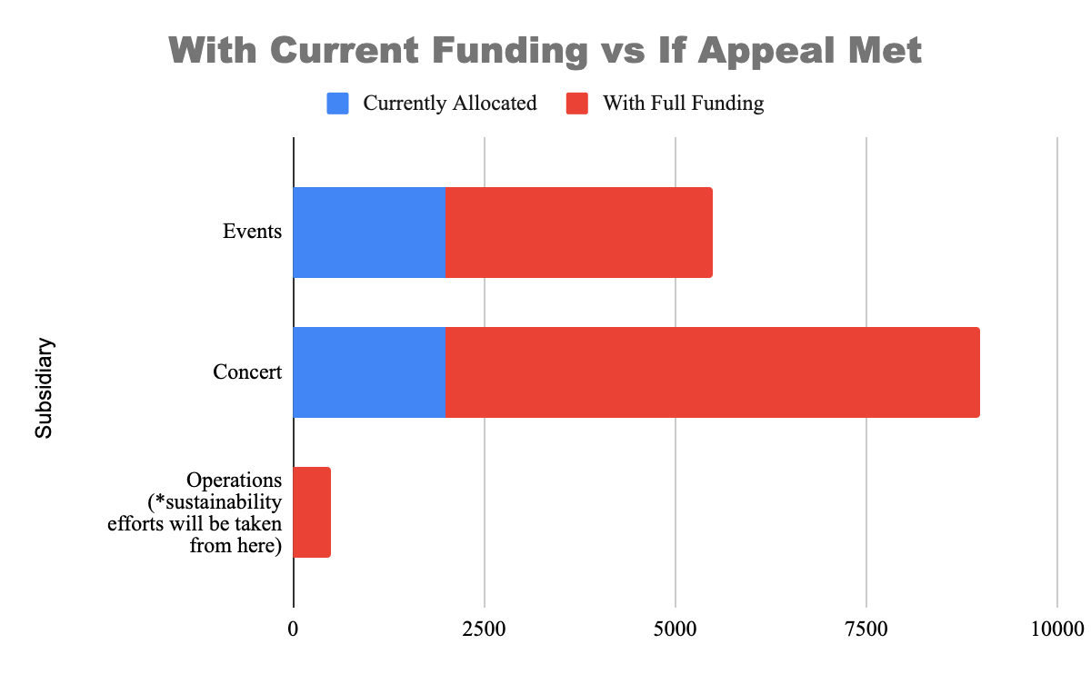
The Ask vs. The Appeal
Requested: $149,924
Allocated: $145,000
Appeal: $4,924

Slide 4

Breakdown of the Allocation Request
We are asking for an additional $4,924 (or a total of $149,924)
New Events
Goat Yoga, Off-Campus Events (SoulCycle or Museum visits), General Member ideas
Sustainability efforts
Uphold our Sustainability Commitment that we as an organization promised in Spring 2019
Reusable tablecloths, utensils, etc
Higher Quality Concert
Unconsidered costs include staging, GUPD, agent fees, external vendors, etc
Strive to make the concert free to students like we did Spring 2017
Afford more distinguished artists

Slide 5

Event Increase
$3,500 allows for general members to contribute new ideas for events beyond signature events (Mr. Georgetown, Haunted Healy, etc)
Allow for proper planning of larger scale events - needed to turn away students for Funniest Human
Operations Increase
$500 increases use of reusable, sustainable products rather than single use
Purchases would include the following: polyester tablecloths, reusable shopping/supply bags, compostable plates and utensils
Concerts Increase
$7000 improves production value, quality of performer, and ticket prices
Purchase of video wall/lighting rod will afford us a more extensive list of artists
Free concert would bring us closer to low cost high quality mission.

Slide 6

The Importance of GPB
1
The only organization that is responsible for consistent, entertaining programming open to the whole campus. GPB has no membership barriers and works against exclusive club cultures that are common on Georgetown’s campus.
2
GPB engages with the diversity of people at Georgetown and creates memorable experiences for all its students, events that make us proud to be Hoyas.
Our events this year have reached record-setting attendance with 512 students attending Haunted Healy, over 200 students at our Fall Concert, and selling out Gaston Hall (over 600 students) in less than 1 hour for Mr. Georgetown.
3

Slide 7
In Response to COVID-19
In the event that our events will not continue as scheduled:
$113,190.67 will not be used for the originally intended purpose, as the following events have been cancelled:
Spring Concert
Pre-Concert Bash
GPBoat Party
While we are unsure how much of this amount will be put into reserves, realistically a portion of it will be.
This shouldn’t affect the appeal for the following reasons:
Events such as Georgetown Day and Spring Fest will be planned for the students who are on campus, but will change in nature to accommodate both the threat of disease transfer and smaller amount of students.
Preliminary events in the Fall 2020 will be programmed to foster the return of Georgetown spirit after such a pandemonium, as well as smaller programming for students still on campus this Spring
The Spring Concert 2021 will be able to reflect the results from an increase in budget (according to our original presentation) that will reflect the scale of production witnessed at peer universities.
Reserves protect against unforeseen cancellations and alterations in high-risk events, like the concert.

Slide 8
TOTAL ASK AFTER APPEAL...
$149,924.00

Slide 9

Hoya Saxa!
Thank you for your dedication despite the recent university setbacks

